Slide 1

Unveiling FIFA World Cup Insights
This data analysis delves into the rich history of the FIFA World Cup, uncovering compelling insights from match data and player statistics. From legendary top scorers to host country performance, we'll explore the tournament's captivating narratives.

Slide 2
Data Journey
1
Data Acquisition
Data sourced from Unified Mentor.
2
Research
Background research on FIFA and football conducted.
3
Data Cleaning
Python (pandas, datetime, numpy) and Excel used for cleaning.
4
Data Visualization
Power BI leveraged for creating visualizations.
5
Insights & Reporting
Insights derived from visualizations, culminating in a report and presentation.

Slide 3

Top Performers
Appearances
Victories
Goals
Brazil and Germany lead with 78 matches each.
Brazil boasts 58 wins, followed by Germany with 53.
Ronaldo (13 goals) surpasses Klose (12 goals) as the top scorer.

Slide 4

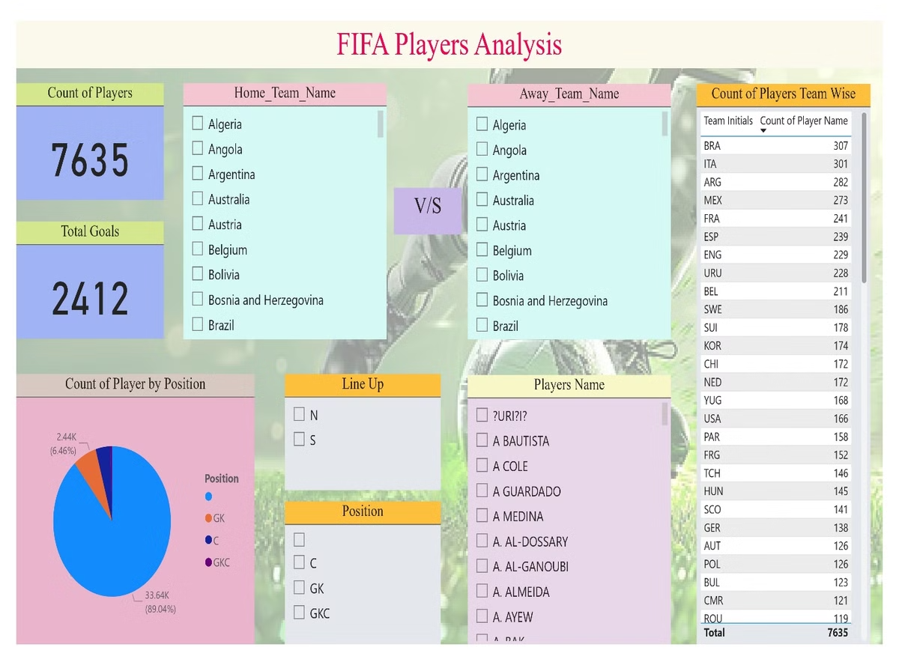
Match Dynamics
1
Average Goals
Recent tournaments average around 2.5 goals per match.
2
Penalty Shootouts
Increasingly common in knockout stages, with Germany excelling.
3
Late Goals
A significant portion occur in the final 15 minutes.

Slide 5

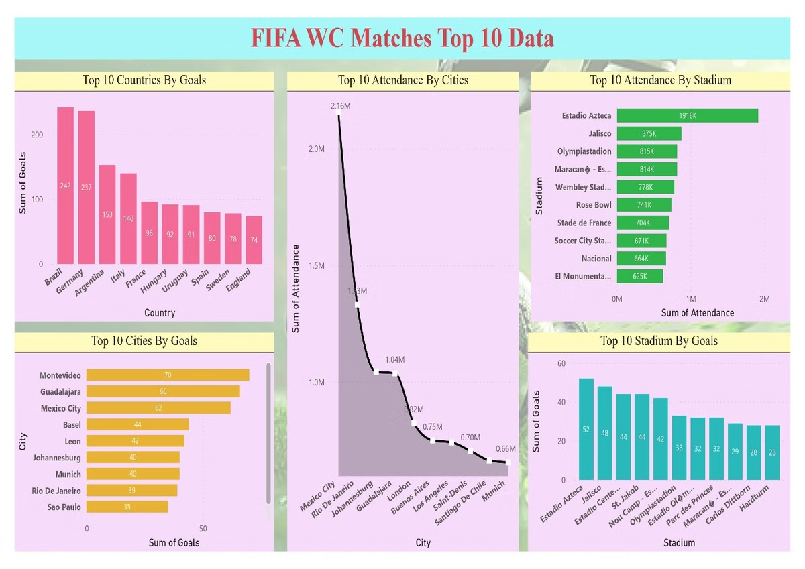
Global Stage
Host Nations
Six host countries have emerged victorious, with 15 finishing in the top four.
Regional Dominance
Europe leads with 12 World Cup wins, followed by South America with nine.

Slide 6


Records and Milestones
Biggest Win
Youngest Scorer
Hungary's 10-1 victory over El Salvador in 1982 marks a record goal margin.
Brazil's Pelé holds the record for the youngest goal scorer.

Slide 7

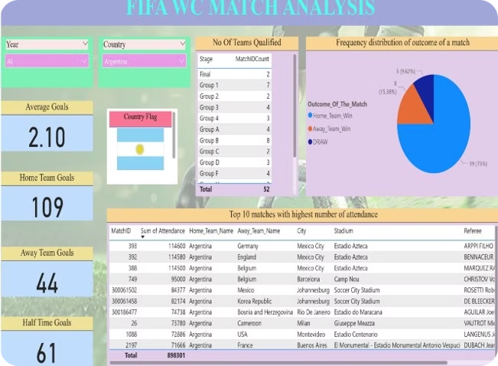
Data Cleaning Highlights
1
Data Integrity
Dropping duplicates and handling missing values ensured data accuracy.
2
Datetime Transformation
Slicing and renaming the 'Datetime' column facilitated temporal analysis.
3
Feature Engineering
Creating new columns like 'Goals' and 'Outcome_Of_The_Match' enriched the dataset.

Slide 8
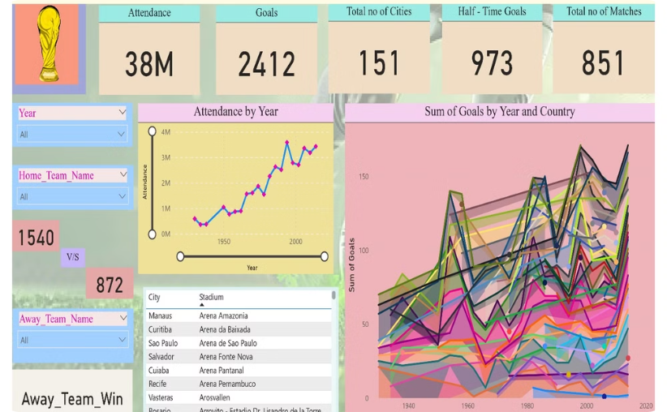
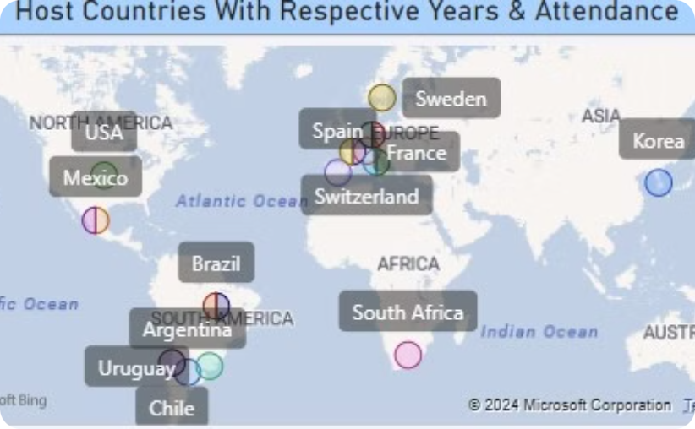
Visualizing the Data
Attendance Over Time
Geographic Distribution
Visualizing attendance trends reveals the growing global appeal of the World Cup.
Mapping host cities and match locations highlights the tournament's global reach.

Slide 9
Insights from WC Players & WC’s
Top Scorers (Goals): • RONALDO: 13 goals • KLOSE: 12 goals • Uwe SEELER: 9 goals • MÜLLER: 9 goals • Gerd MUELLER: 9 goals
Player Participation by Team: • Brazil: 2,403 players • Italy: 1,843 players • Argentina: 1,807 players • England: 1,378 players • West Germany (FRG): 1,364 players
Coach Appearances: • Luiz Felipe Scolari (Brazil): 575 appearances • Helmut Schoen (FRG): 550 appearances • Carlos Alberto Parreira (Brazil): 514 appearances
Goals by Player Position: • C (Center): 144 goals
Position Frequency: • Goalkeeper (GK): 2,441 players • Center (C): 1,510 players
Goals Trend Over Time: • Goals increased from 70 in 1930 to a peak of 171 in 1998 and 2014.
Top World Cup Winners: • Brazil: 5 wins • Italy: 4 wins • Germany: 4 wins
Top World Cup Finalists: • Germany: 4 times finalist • Argentina: 3 times finalist • Netherlands: 3 times finalist
Attendance Trends Over Time: • Attendance rose significantly from 590,549 in 1930 to 3,587,538 in 1994, with recent tournaments drawing millions of spectators.
Host Country Wins: • Host countries have won the World Cup 6 times.
Host Country Top 4 Finishes: • Host countries finished in the top 4, 15 times.

Slide 10

Thank you for your time and attention.
We hope you found this presentation insightful and informative. We'd love to hear your thoughts and feedback. Please reach out to us if you have any questions or want to discuss further.

